Slide 1
SENG 1000 - Software Engineering Foundations and Practice
-Sumati

Slide 2
Topics
Classes and Object-Oriented Programming
Procedural and Object-Oriented Programming
OOP Concepts
Object
Class
Data Abstraction and Encapsulation
Inheritance
Polymorphism

Slide 3
Procedural vs. Object-Oriented
Procedural programming
It is a programming practice centered on the procedures or actions that take place in a program.
Object-oriented programming
It is centered on objects.
Objects are created from abstract data types that encapsulate data and functions together.

Slide 4
OOP Concepts
Object
Class
Data Abstraction and Encapsulation
Inheritance
Polymorphism

Slide 5
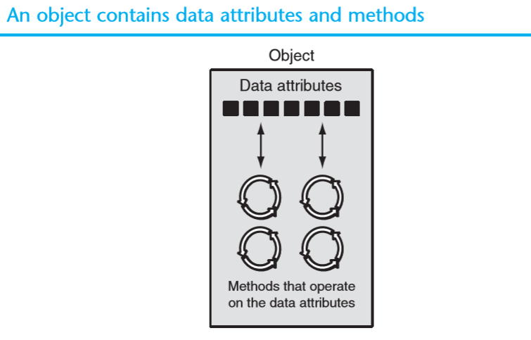
Object
Basic unit of program.
An object is a software entity that contains both state(data) and behavior(methods).
The data contained in an object is known as the object’s data attributes.
An object’s methods are functions that perform operations on the object’s data attributes.

Slide 6
Class
Class is a blueprint for an object.
A class definition is a set of statements that define a class’s methods and data attributes.
This doesn't define any data, but it does define what the class name means.
class ClassName:
<statement-1>
.
.
<statement-N>

Slide 7
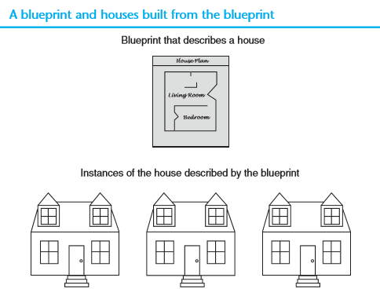
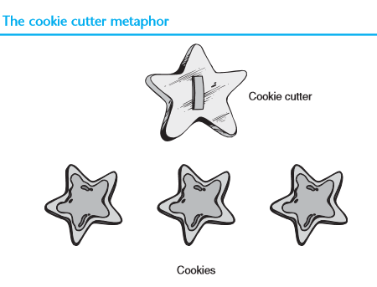
Blueprint vs. Instance

Slide 8
Data Abstraction & Encapsulation
Abstraction
Provide only essential information to the outside world and hide their background details
Achieved through encapsulation.
For example, a database system hides certain details of how data is stored and created and maintained.
Encapsulation
Wrapping up of data and functions into a single unit (called class) is called as Encapsulation
This is to prevent data from direct modification from outside world and is called as Data Hiding or Information Hiding

Slide 9
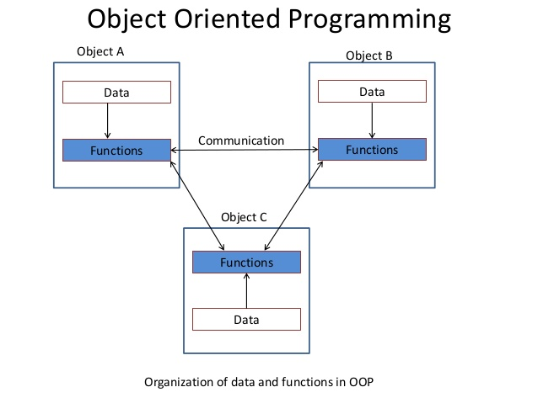
Organization of Data and Functions in OOP

Slide 10
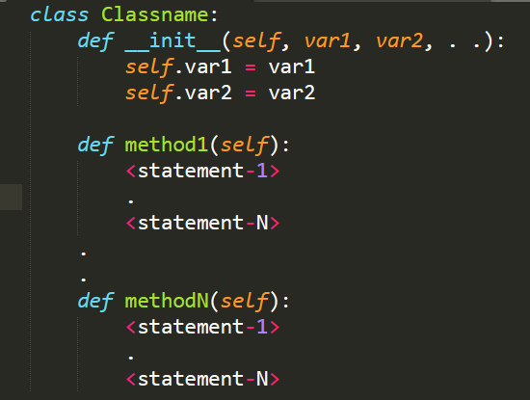
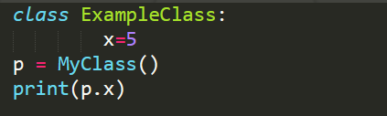

Classes & Objects (cont.…)

Slide 11
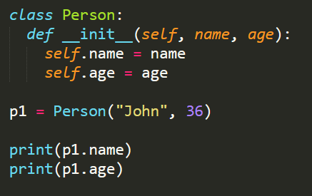
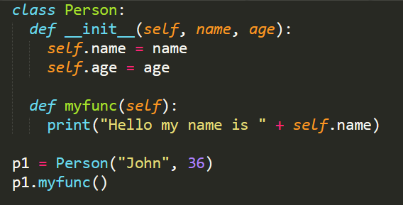
Classes & Objects (cont.…)

Slide 12
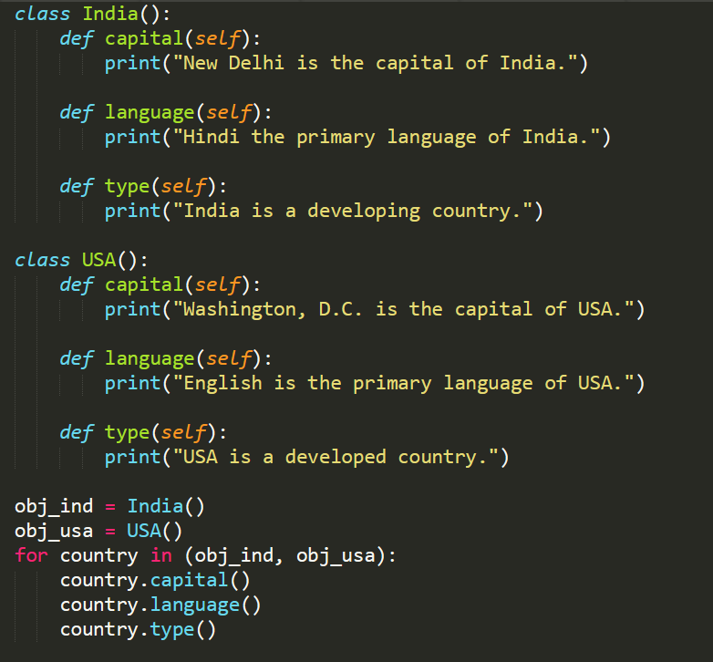
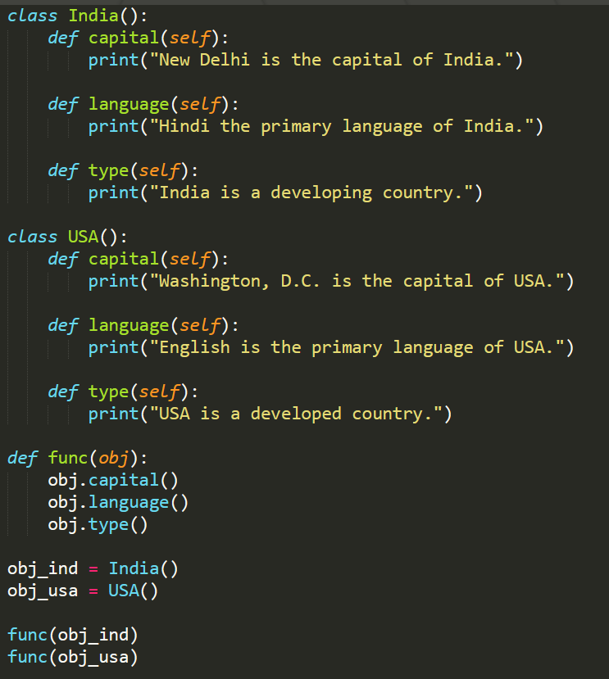
Classes & Objects (cont.…)

Slide 13
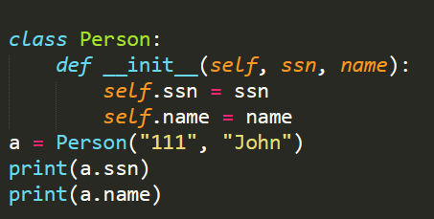
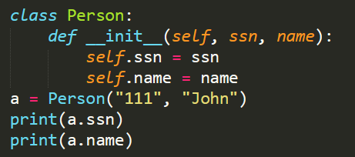
Classes & Objects (cont.…)

Slide 14
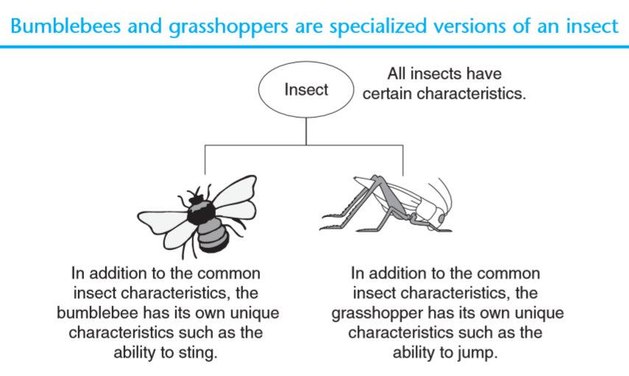
Inheritance
It is a process by which objects of one class acquire properties of objects of another class.
It is the most useful aspects of OOP and provides code reusability.
Inheritance involves a superclass and a subclass.
The subclass inherits attributes and methods from the superclass

Slide 15
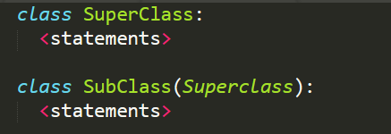
Inheritance (cont..)

Slide 16
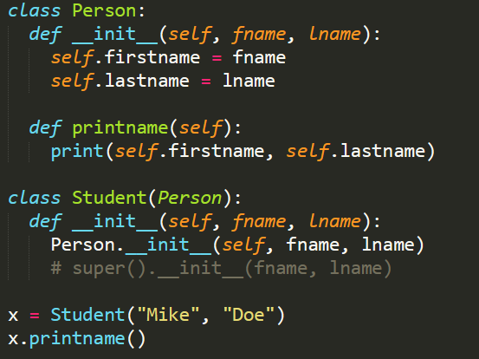
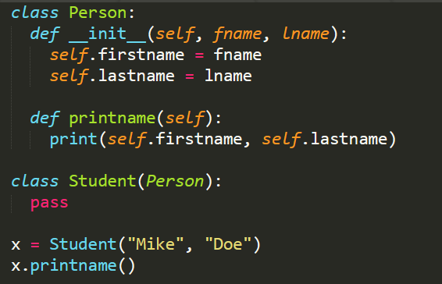
Inheritance (contd..)

Slide 17
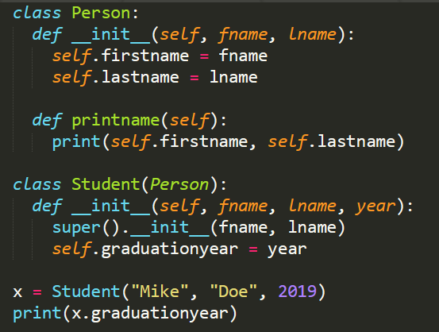
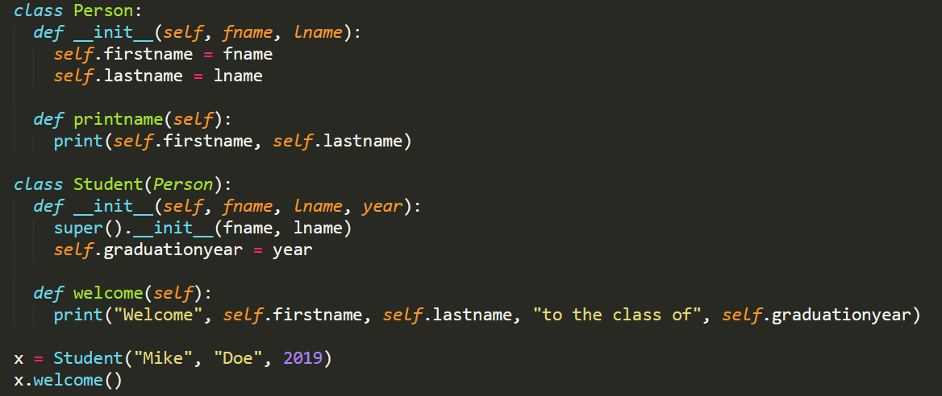
Inheritance (contd..)

Slide 18
Polymorphism
Polymorphism refers to an object’s ability to take different forms
When a method is defined in a superclass and define the method with the same name in a subclass.
Subclass method overrides the superclass method.
The call to correct version of overridden method depends on the object that is used to call
If subclass object is used for call, subclass’s version will execute
If superclass object is used for call, superclass’s version will execute

Slide 19
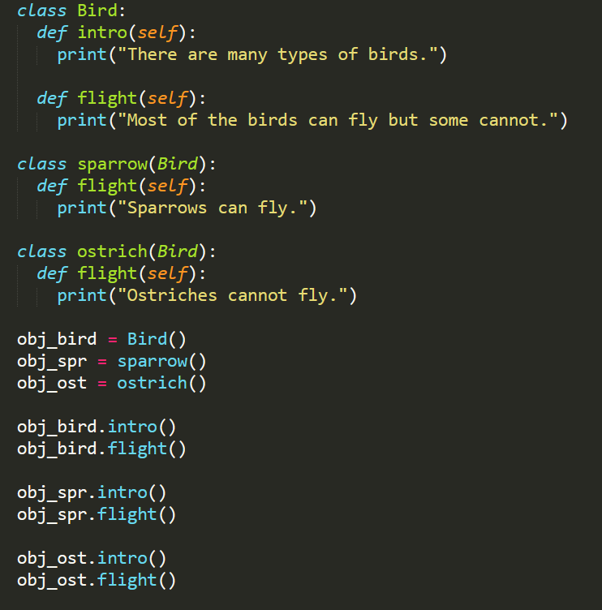
Polymorphism (contd..)

